Slide 1
Asia Cup
File created on: 1/13/2024 8:05:05 PM

Slide 2
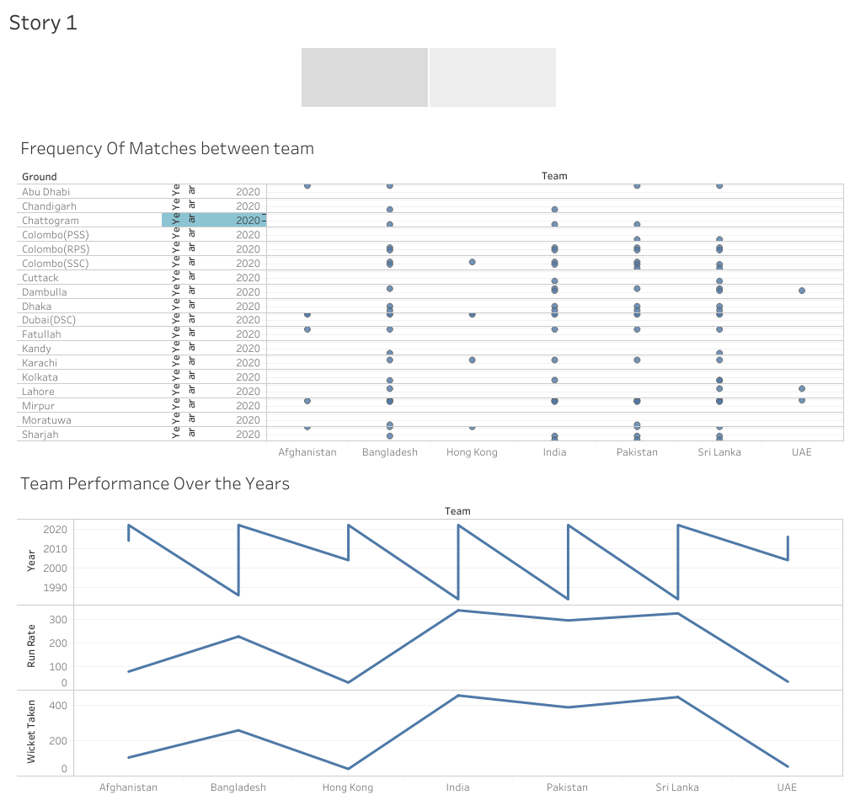

Slide 3
